Slide 1
Struts 2.0 Basics 2/2

Slide 2
Agenda
Navigation
ValueStack
Interceptors
Validations

Slide 3
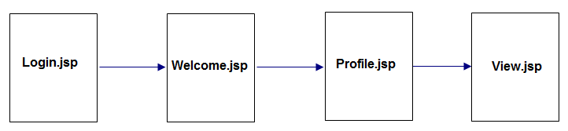
Navigation
Using action and result tag
Configuration in struts.xml
For example as following here:
Create 2 files: Profile.jsp and View.jsp
Profile.jsp allows input profile information
View.jsp: will display profile information after submit a button from Profile.jsp

Slide 4
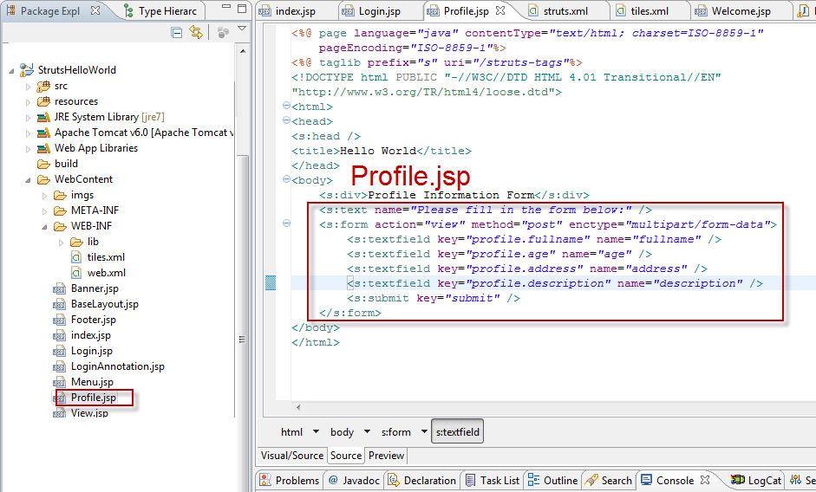
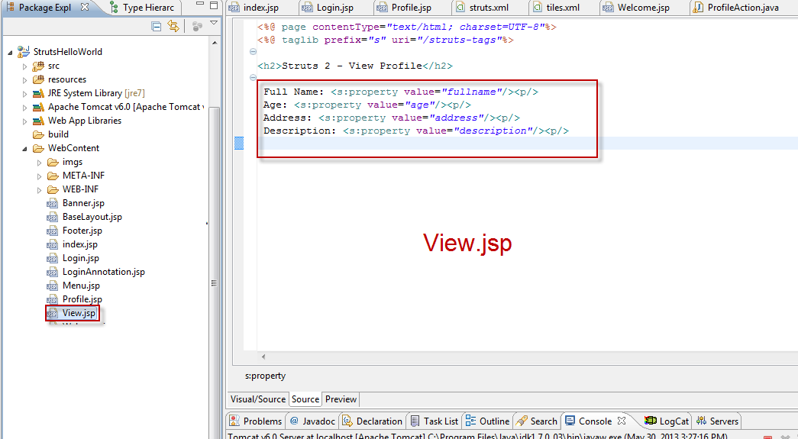
Navigation
Profile.jsp and View.jsp:
Notes:
<%@ page language="java" contentType="text/html; charset=ISO-8859-1"
pageEncoding="ISO-8859-1"%>
<%@ taglib prefix="s" uri="/struts-tags"%>
<!DOCTYPE html PUBLIC "-//W3C//DTD HTML 4.01 Transitional//EN"
"http://www.w3.org/TR/html4/loose.dtd">
<html>
<head>
<s:head />
<title>Hello World</title>
</head>
<body>
<s:div>Profile Information Form</s:div>
<s:text name="Please fill in the form below:" />
<s:form action="view" method="post" enctype="multipart/form-data">
<s:textfield key="profile.fullname" name="fullname" />
<s:textfield key="profile.age" name="age" />
<s:textfield key="profile.address" name="address" />
<s:textfield key="profile.description" name="description" />
<s:submit key="submit" />
</s:form>
</body>
</html>
======================View.jsp==========================
<%@ page contentType="text/html; charset=UTF-8"%>
<%@ taglib prefix="s" uri="/struts-tags"%>
<h2>Struts 2 - View Profile</h2>
Full Name: <s:property value="fullname"/><p/>
Age: <s:property value="age"/><p/>
Address: <s:property value="address"/><p/>
Description: <s:property value="description"/><p/>

Slide 5
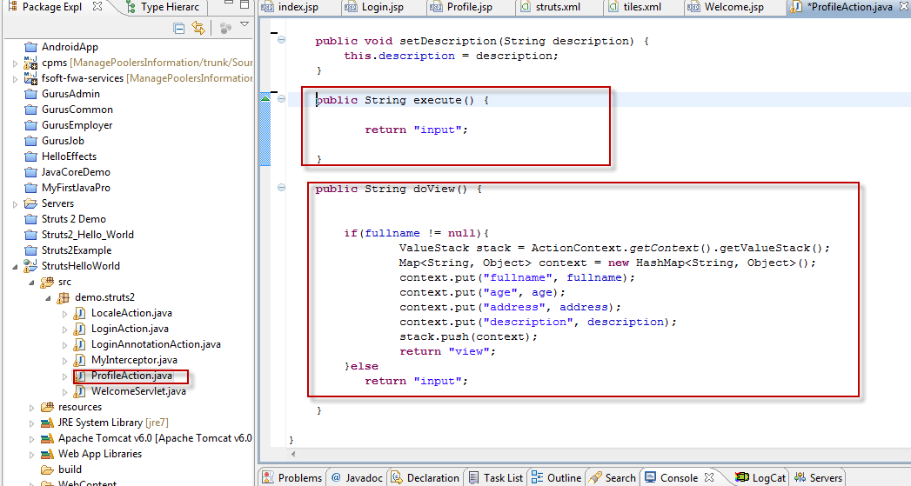
Navigation
Create ProfileAction class with 2 methods: execute() and doView():
Notes:
package demo.struts2;
import java.util.HashMap;
import java.util.Map;
import com.opensymphony.xwork2.ActionContext;
import com.opensymphony.xwork2.ActionSupport;
import com.opensymphony.xwork2.util.ValueStack;
import org.apache.tiles.impl.BasicTilesContainer;
public class ProfileAction extends ActionSupport {
/**
*
*/
private static final long serialVersionUID = 1L;
private String fullname;
private String address;
private String age;
private String description;
public String getFullname() {
return fullname;
}
public void setFullname(String fullname) {
this.fullname = fullname;
}
public String getAddress() {
return address;
}
public void setAddress(String address) {
this.address = address;
}
public String getAge() {
return age;
}
public void setAge(String age) {
this.age = age;
}
public String getDescription() {
return description;
}
public void setDescription(String description) {
this.description = description;
}
public String execute() {
return "input";
}
public String doView() {
if(fullname != null){
ValueStack stack = ActionContext.getContext().getValueStack();
Map<String, Object> context = new HashMap<String, Object>();
context.put("fullname", fullname);
context.put("age", age);
context.put("address", address);
context.put("description", description);
stack.push(context);
return "view";
}else
return "input";
}
}

Slide 6
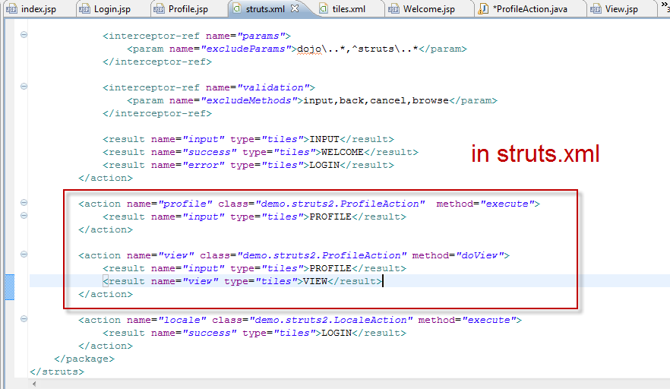
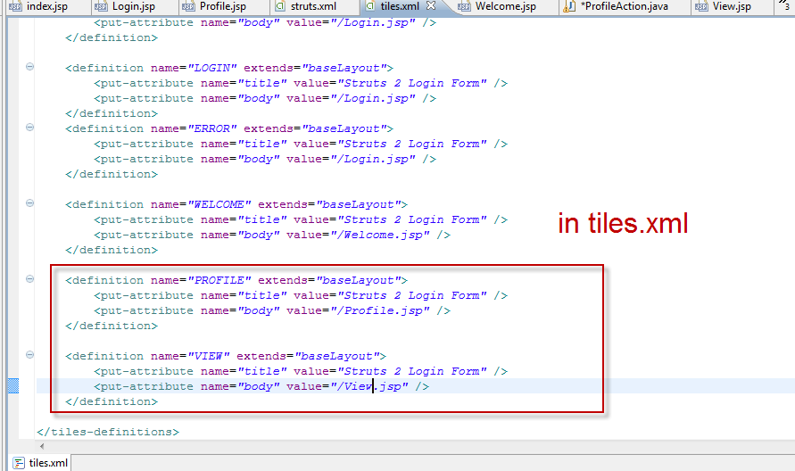
Navigation
Configuration in struts.xml and tiles.xml as bello here:
Notes:
<%@ page contentType="text/html; charset=UTF-8"%>
<%@ taglib prefix="s" uri="/struts-tags"%>
<h2>Struts 2 - View Profile</h2>
Full Name: <s:property value="fullname"/><p/>
Age: <s:property value="age"/><p/>
Address: <s:property value="address"/><p/>
Description: <s:property value="description"/><p/>

Slide 7
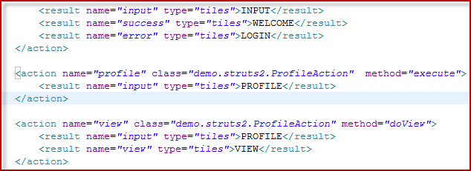
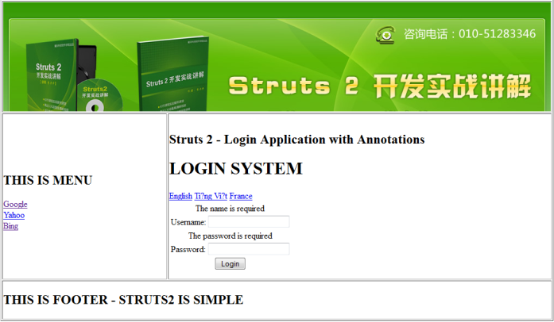
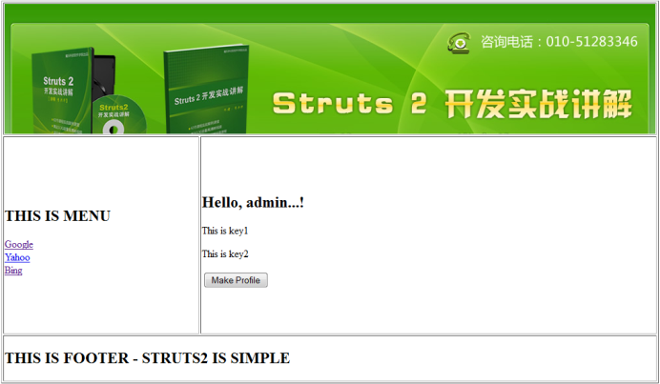
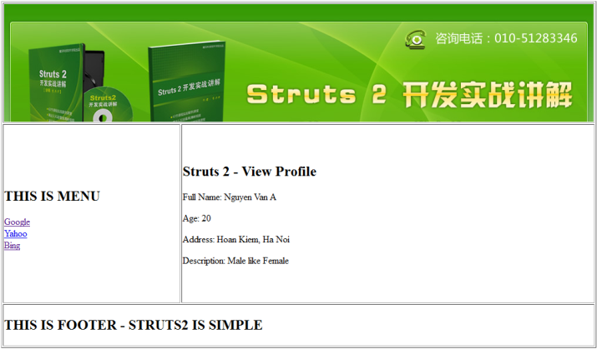
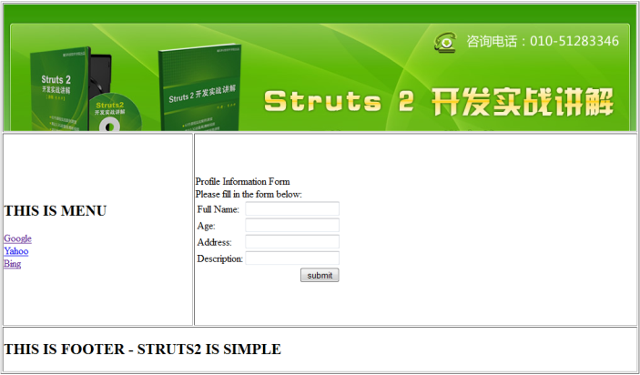
Navigation
Run & View:
2
1
3
5
4
6

Slide 8
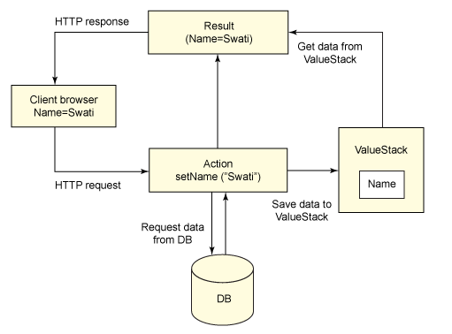
Value Stack
An object that holds all the data that gets associated during the processing of a request.
Can be accessed via the tags provided for JSP, Velocity or Freemarker.
Can get valueStack object inside your action as follows: ActionContext.getContext().getValueStack()

Slide 9
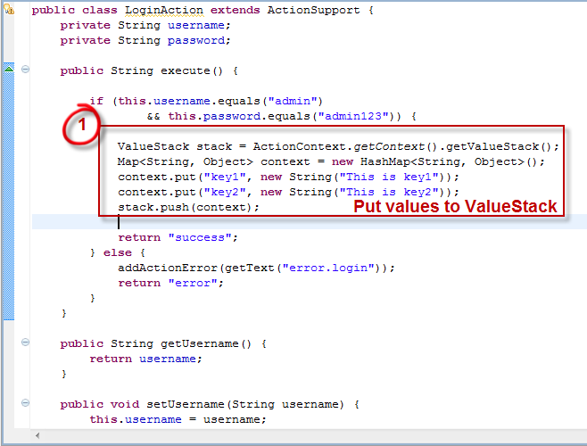
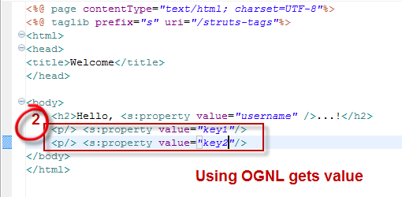
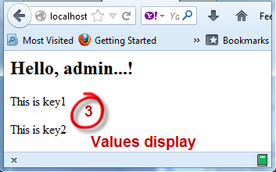
Value Stack
Set, get value with ValueStack
Notes:
public String execute() {
System.out.println("Code in processing...");
if (this.username.equals("admin")
&& this.password.equals("admin123")) {
ValueStack stack = ActionContext.getContext().getValueStack();
Map<String, Object> context = new HashMap<String, Object>();
context.put("key1", new String("This is key1"));
context.put("key2", new String("This is key2"));
stack.push(context);
return "success";
} else {
addActionError(getText("error.login"));
return "error";
}
}

Slide 10
Interceptors

Slide 11
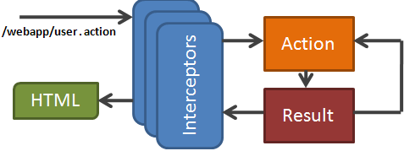
Overview & Architecture
Are conceptually the same as servlet filters (refer to next slide)
Can achieve the following using interceptors:
Providing preprocessing logic before the action is called.
Providing postprocessing logic after the action is called.
Catching exceptions so that alternate processing can be performed.
Notes:
servlet filters : Teacher should explain detail in next slide

Slide 12
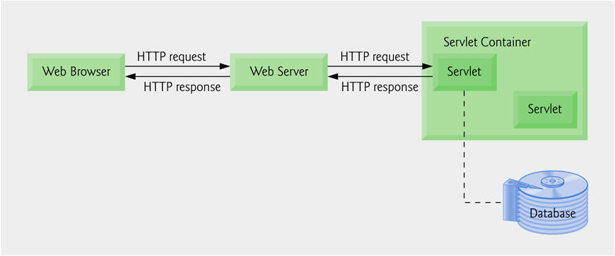
Servlet & Servlet filtlers
Java Servlets are server-side Java program modules that process and answer client requests and implement the servlet interface.
A servlet acts as an intermediary between the client and the server.
Servlet modules run on the server, they can receive and respond to requests made by the client

Slide 13
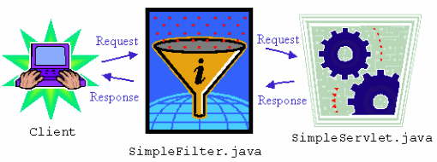
Servlet & Servlet filtlers
Servlet filters are used to check for something which is common across all the users of the web application.
Using Servlet filters when you want to filter and/or modify requests based on specific conditions before sent request/response
Notes:
When the servlet container calls a method in a servlet on behalf of the client, the HTTP request that the client sent is, by default, passed directly to the servlet. The response that the servlet generates is, by default, passed directly back to the client, with its content unmodified by the container. So, normally, the servlet must process the request and generate as much of the response as the application requires.
But there are many cases where some preprocessing of the request for servlets would be useful. In addition, it is sometimes useful to modify the response from a class of servlets. One example is encryption. A servlet, or a group of servlets in an application, might generate response data that is sensitive and should not go out over the network in clear-text form, especially when the connection has been made using a non-secure protocol such as HTTP. A filter can encrypt the responses. Of course, in this case the client must be able to decrypt the responses.
A common case for a filter is where you want to apply pre-processing or post-processing to requests and responses for a group of servlets, not just a single servlet. If you need to modify the request or response for just one servlet, there is no need to create a filter--just do what is required directly in the servlet itself.

Slide 14
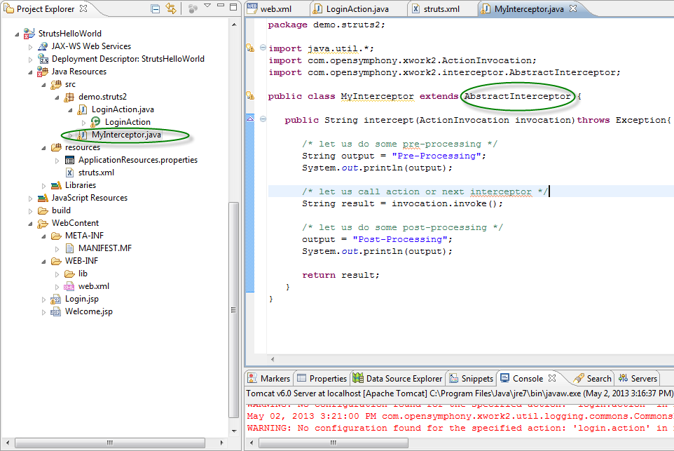
Create Custom Interceptors
Creating a MyInterceptor class
Extend AbtractInterceptor interface

Slide 15
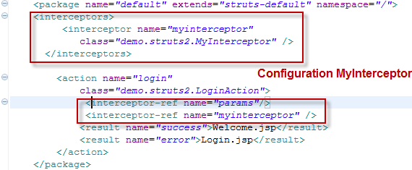
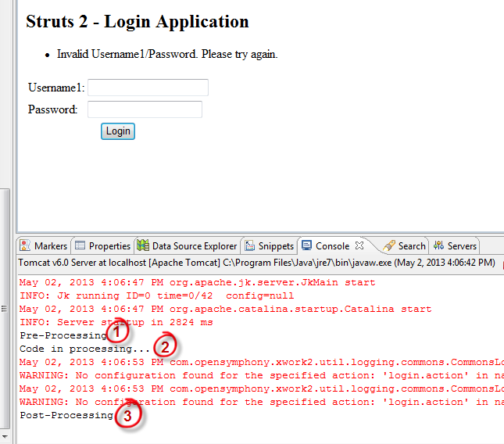
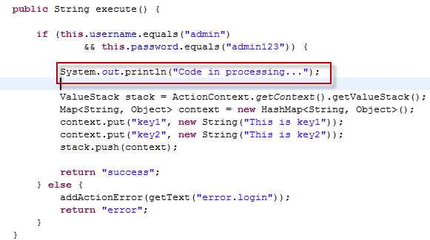
Interceptors Configuration
- In struts.xml file:
- After running application
- In execute()method in LoginAction class:
Notes:
public void validate()
{
if (username == null || username.trim().equals(""))
{
addFieldError("username","The name is required");
}
if (password == null || password.trim().equals(""))
{
addFieldError("password","The password is required");
}
}

Slide 16
Validations
Notes:
Field validators, as the name indicate, act on single fields accessible through an action. A validator, in contrast, is more generic and can do validations in the full action context, involving more than one field (or even no field at all) in validation rule. Most validations can be defined on per field basis. This should be preferred over non-field validation wherever possible, as field validator messages are bound to the related field and will be presented next to the corresponding input element in the respecting view.
Non-field validators only add action level messages. Non-field validators are mostly domain specific and therefore offer custom implementations. The most important standard non-field validator provided by XWork is ExpressionValidator.

Slide 17
Overview
- Provided by XWork to enable the application of input validation rules to Actions before they are executed
- To handle form validation automatically and it can handle both server side as well as client side form validation
Validators Scope
Field Validators: as the name indicate, act on single fields accessible through an action
Non-field validators: only add action level messages
Notes:
Field validators, as the name indicate, act on single fields accessible through an action. A validator, in contrast, is more generic and can do validations in the full action context, involving more than one field (or even no field at all) in validation rule. Most validations can be defined on per field basis. This should be preferred over non-field validation wherever possible, as field validator messages are bound to the related field and will be presented next to the corresponding input element in the respecting view.
Non-field validators only add action level messages. Non-field validators are mostly domain specific and therefore offer custom implementations. The most important standard non-field validator provided by XWork is ExpressionValidator.

Slide 18
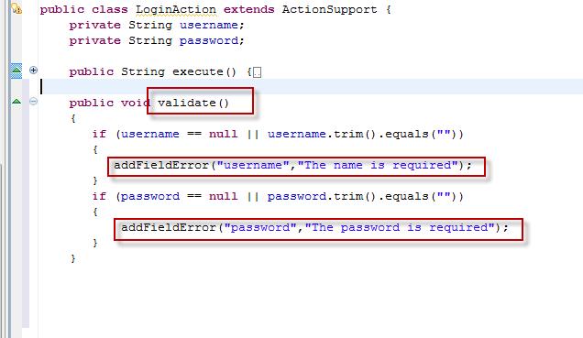
Create Validation
Overwrite validate() method in LoginAction class
Use addFielError() to put error message
Notes:
How this validation works?
When the user presses the submit button, Struts 2 will automatically execute the validate method and if any of the if statements listed inside the method are true, Struts 2 will call its addFieldError method. If any errors have been added then Struts 2 will not proceed to call the execute method. Rather the Struts 2 framework will return input as the result of calling the action.
So when validation fails and Struts 2 returns input, the Struts 2 framework will redisplay the index.jsp file. Since we used Struts 2 form tags, Struts 2 will automatically add the error messages just above the form filed.
These error messages are the ones we specified in the addFieldError method call. The addFieldError method takes two arguments. The first is the form field name to which the error applies and the second is the error message to display above that form field.
addFieldError("name","The name is required"); To handle the return value of input we need to add the following result to our action node in struts.xml.

Slide 19
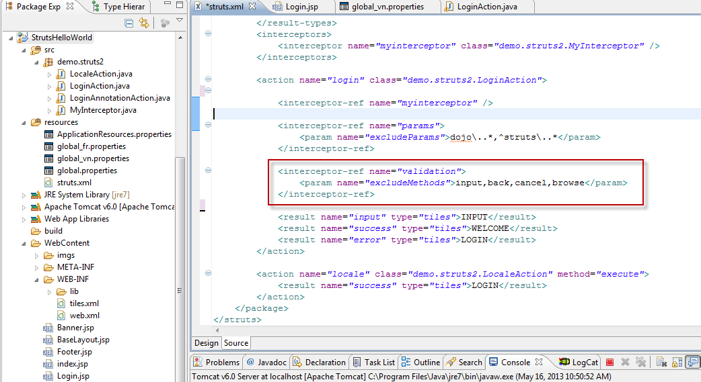
Validation Configuration
Configuration in struts.xml
Use interceptor –ref with name “validation”
Notes:
<?xml version="1.0" encoding="UTF-8" ?>
<!DOCTYPE struts PUBLIC
"-//Apache Software Foundation//DTD Struts Configuration 2.0//EN"
"http://struts.apache.org/dtds/struts-2.0.dtd">
<struts>
<constant name="struts.enable.DynamicMethodInvocation" value="false" />
<constant name="struts.devMode" value="false" />
<constant name="struts.custom.i18n.resources" value="global" />
<package name="default" extends="struts-default" namespace="/">
<result-types>
<result-type name="tiles"
class="org.apache.struts2.views.tiles.TilesResult" />
</result-types>
<interceptors>
<interceptor name="myinterceptor" class="demo.struts2.MyInterceptor" />
</interceptors>
<action name="login" class="demo.struts2.LoginAction">
<interceptor-ref name="myinterceptor" />
<interceptor-ref name="params">
<param name="excludeParams">dojo\..*,^struts\..*</param>
</interceptor-ref>
<interceptor-ref name="validation">
<param name="excludeMethods">input,back,cancel,browse</param>
</interceptor-ref>
<result name="input" type="tiles">INPUT</result>
<result name="success" type="tiles">WELCOME</result>
<result name="error" type="tiles">LOGIN</result>
</action>
<action name="locale" class="demo.struts2.LocaleAction" method="execute">
<result name="success" type="tiles">LOGIN</result>
</action>
</package>
</struts>

Slide 20
Summary
ValueStack: An object that holds all the data that gets associated during the processing of a request
Use Interceptor to preprocess and postprocess logics, catch exception

Slide 21
Q & A

